Slide 1
Tobacco Control Health Needs Assessment
Summary Slide-deck
Version 22 July 2019
The information in this slide deck is extracted from the Derbyshire 2019 Tobacco Control Health Needs Assessment
Full details can be found in the reference document available at [Derbyshire Observatory link]

Slide 2
Overview
Tobacco remains the single-most harmful legal substance to health. Smoking is the leading cause of preventable deaths and early deaths in the UK and in Derbyshire.
Sadly, smoking is responsible for six deaths a day in Derbyshire.
And tobacco use is a major cause of ill health particularly from cardiovascular disease, respiratory diseases, and lung cancer. There are particular health risks for children exposed to secondhand smoke, and from smoking in pregnancy.
Approximately 1 million cigarettes are smoked each day in Derbyshire. Yet there are opportunities to strengthen our efforts to reduce the harms associated with smoking.
This summary highlights the key messages from a health needs assessment that has been developed to bring together data and evidence to inform the development and delivery of local tobacco control work.

Slide 3
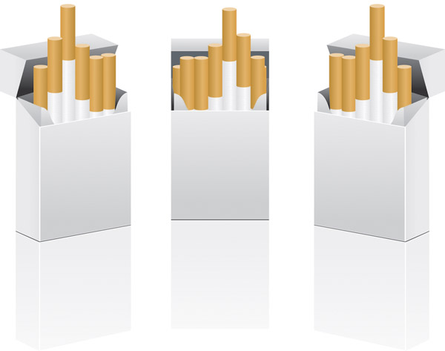
Smoking in Derbyshire: key facts
Smoking is the biggest killer: 16 in every 100 deaths
88750 adults smoke
1 million cigarettes each day
1068 women smoke at the time their baby is born
Smoking costs Derbyshire £174.7 million each year
Smoking reduces life expectancy and increases inequalities

Slide 4
Who is smoking in Derbyshire?
Approximately 88750 adults (13.9% of the population) are current smokers.
Higher smoking rates among lower socioeconomic groups and people with mental illness:
23.3% of routine and manual workers are current smokers.
39.9% (1703) adults with serious mental illness smoke.
28.9% of adults with long term mental health condition smoke.
15% of young people have tried a cigarette, 3% of those who tried now smoke daily. 25.2% of 15 year olds have tried e-cigarettes.
Smoking prevalence varies slightly between the districts; more adult smokers live in Amber Valley and Chesterfield.
15.4% of pregnant women were smoking at the time of delivery (1068 women). This is significantly higher than the England average (10.8%).
 | Estimated number of smokers
Amber Valley | 15,728
Chesterfield | 14,658
South Derbyshire | 11,588
Bolsover | 11,557
High Peak | 11,536
Erewash | 10,148
North East Derbyshire | 7,662
Derbyshire Dales | 5,620

Slide 5
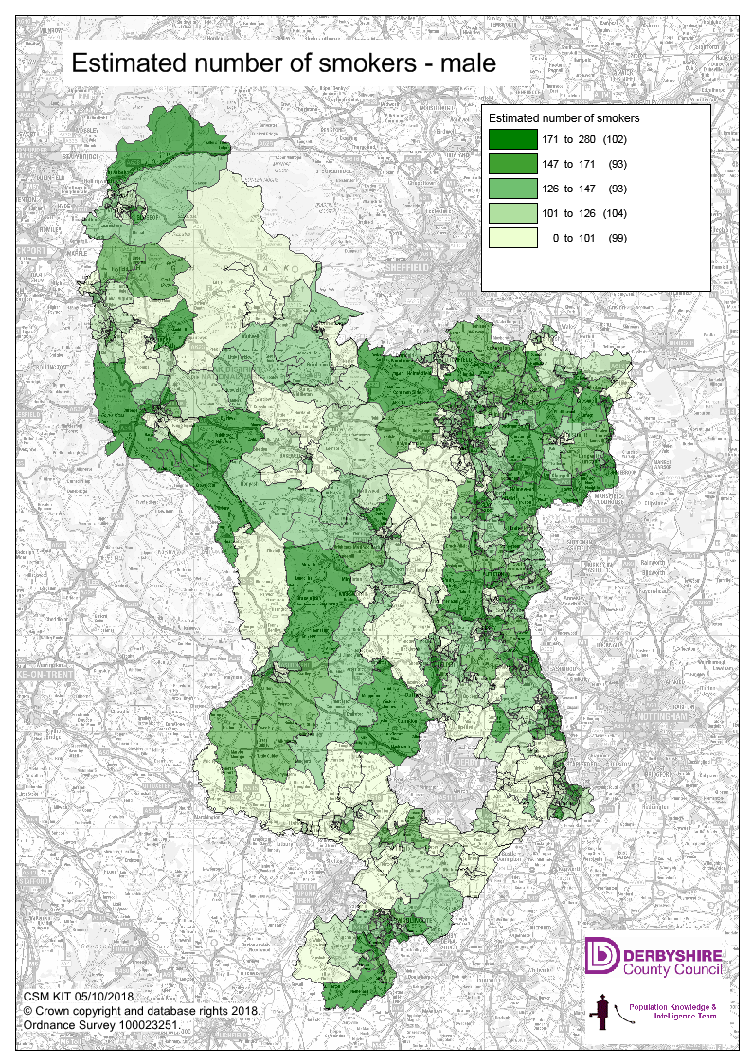
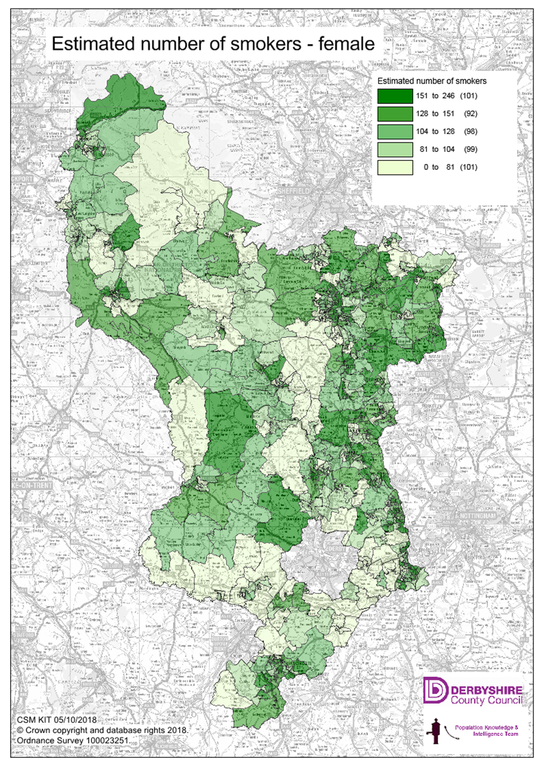
Who is smoking in Derbyshire?

Slide 6
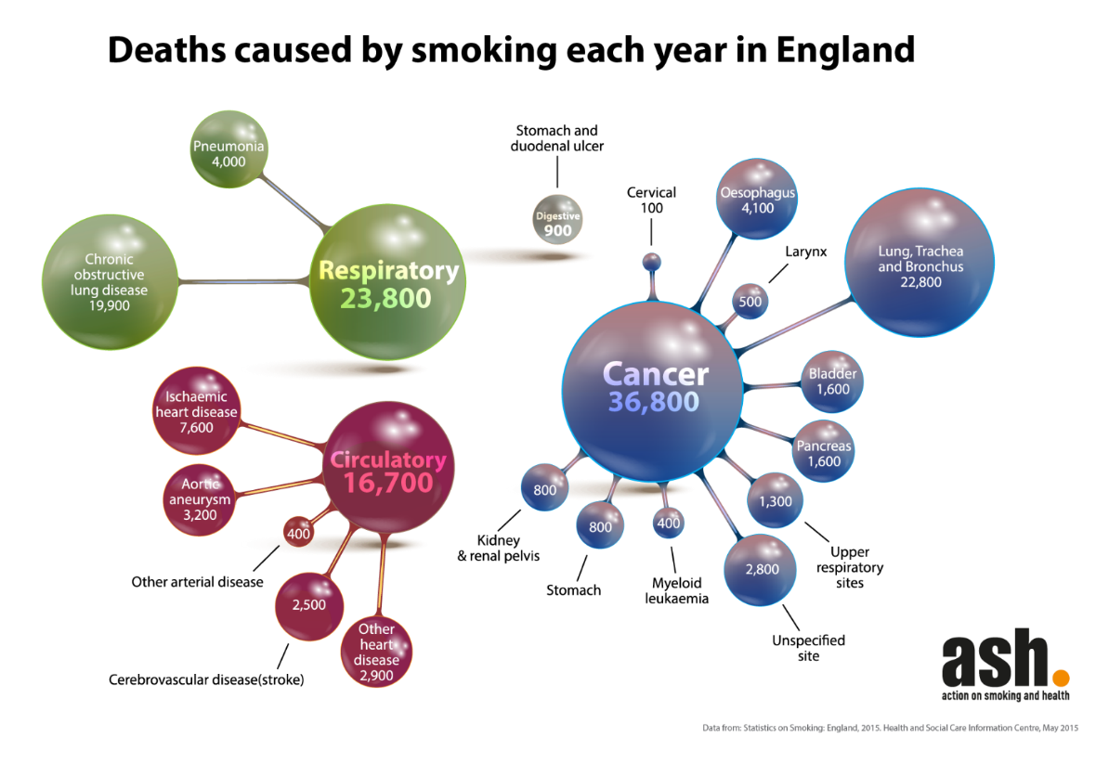
What are the impacts of smoking in Derbyshire?
Deaths
16 in every 100 deaths in Derbyshire can be related to smoking
Approximately 2200 deaths in Derbyshire were caused by smoking in 2018 such that smoking was responsible for 6 deaths each day
Smoking in pregnancy makes still birth twice more likely and sudden infant death three times more likely

Slide 7
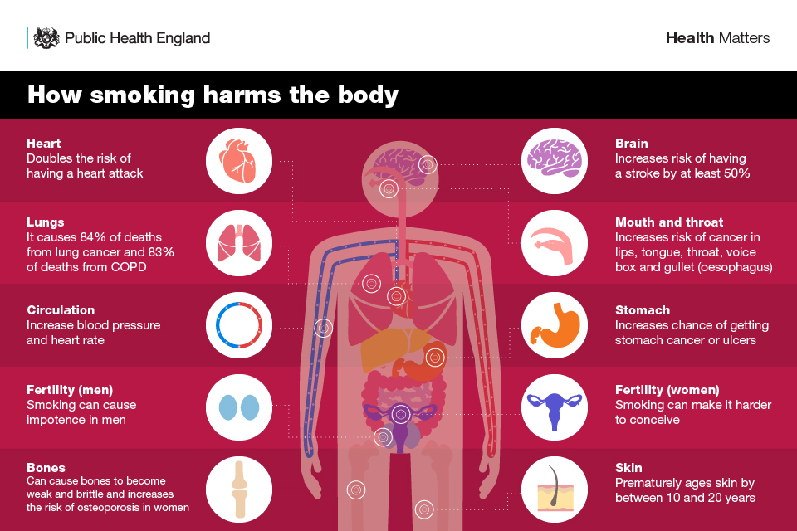
What are the impacts of smoking in Derbyshire?
Illness and use of health services
Treating smoking-related illnesses such as cancers, respiratory diseases, and cardiovascular diseases annually requires:
8138 hospital admissions
363,053 GP consultations
127,055 practice nurse consultations
202,626 GP prescriptions
73,269 outpatient visits
This costs the local NHS £39.6 million

Slide 8
What are the impacts of smoking in Derbyshire?
Reduced Life expectancy
• Smoking is responsible for half of the differences in life expectancy between the most and least affluent
• If 3200 male smokers quit, the healthy life expectancy would rise to 64.0 years, higher than the national average
• If 10084 female smokers quit, the healthy life expectancy would rise to 64.3 years, higher than the national average
Costs to the economy
108.9 million potential wealth is lost from the economy due to early deaths, sick leave and smoking breaks
Overall across health, social care, fire and rescue service, and the impacts on productivity, smoking costs Derbyshire £174.7 million each year
And then, most people who quit smoking save around £3000 per year which can boost household incomes

Slide 9
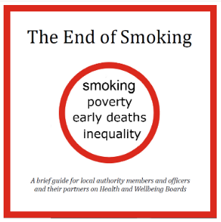
What is Tobacco Control?
Tobacco Control
• supply, demand and harm reduction strategies that aim to improve the health by eliminating or reducing the consumption of tobacco and exposure to tobacco smoke
Ambitions in the Tobacco Control Plan for England 2017-2022:
achieve a smokefree generation
support smokers to quit
eliminate variation in smoking rates
ensure effective enforcement
NHS Long Term Plan
Commitments to action on prevention and health:
a significant new contribution to making England a smoke-free society, by supporting people in contact with NHS services to quit
a new smoke-free pregnancy pathway including focused sessions and treatments.
a new universal smoking cessation offer available as part of specialist mental health services for long-term users of specialist mental health, and in learning disability services.
Tobacco ‘endgame’
Increasing emphasis on achieving a smoking prevalence rate of 5% or lower
ASH have set a challenge for local areas to reach this by 2029
Local commitment
‘Enable people in Derbyshire to live healthy lives’ is a priority in the Derbyshire Health and Wellbeing Strategy 2018 - 2023

Slide 10
What progress has been made?
Decreasing prevalence
If a linear trend continues the overall prevalence is likely to fall below 10% by 2024.
Important inequalities persist: the smoking prevalence could still be 15% in routine and manual workers in 2024

Slide 11
What progress has been made?
Smoking rates in pregnant women
Slower decline in smoking rates in pregnant women
The national ambition is for a smoking in pregnancy rate of less than 6% by 2022
Derbyshire is projected to have a rate of 13% in 2022/23
Effective tobacco control measures
reduce the uptake of smoking
increase the number of quit attempts
improve the success of the quit attempts made
need to be achieved within the population groups who are more tobacco dependent

Slide 12
What progress has been made?
Smoking rates in pregnant women
Slower decline in smoking rates in pregnant women
The national ambition is for a smoking in pregnancy rate of less than 6% by 2022
Derbyshire is projected to have a rate of 13% in 2022/23
Effective tobacco control measures
reduce the uptake of smoking
increase the number of quit attempts
improve the success of the quit attempts made
need to be achieved within the population groups who are more tobacco dependent

Slide 13
What is being implemented locally?
Stop smoking services Last year 892 people successfully quit smoking through the Derbyshire stop smoking service (76% of these quits were validated). Half of the individuals making initial contact with the service do not set a quit date, and work is underway to improve the communication materials and standards.
Addressing smoking in pregnancy During 2017/18 only 112 pregnant women in Derbyshire set a quit date, and smoking in pregnancy rates remain high. There is clear evidence for tackling smoking in pregnancy through implementation of NICE Guidance, Baby Clear and the NHS England Saving Babies’ Lives Care Bundle. Further multiagency work and leadership will be required to achieve real progress.
Cheap and illicit tobacco Derbyshire Trading Standards has made substantial seizures of illicit tobacco in recent months, despite changes in service capacity
Smokefree places A local consultation on developing smokefree places is underway as a means of protecting children from secondhand smoke. There may be opportunities through this to increase public awareness of the harms of secondhand smoke.
Health services and reducing smoking Health and social care organisations have demonstrated a commitment to reducing smoking rates within the Joined Up Care Derbyshire Prevention Plan. There is variation in the offer of support within primary care to current smokers. The risky behaviour CQUIN is being rolled out in local hospitals, again highlighting that patients should be supported to access specialist services and be offered medication. Working with outpatients including those pre-surgery needs further consideration to tackle the harms of tobacco dependence.

Slide 14
And what more could be done?
Recommendations
Discuss the findings with Derbyshire Health and Wellbeing Board, and Joined Up Care Derbyshire Board to:
raise the profile call for system-wide leadership and action
invite the development of shared commitments such as a target towards a tobacco free generation
Upscale the cross-organisational work particularly on addressing smoking in pregnancy, building on the commitment within organisations, and to amplify local efforts.
And then to use the learning from the work on smoking in pregnancy to support action on smoking in other population groups.
Consider reconvening a Tobacco Control group for Derbyshire to coordinate local efforts, draw attention to work across partners, and as a mechanism for advocacy for action at regional and national levels.

Slide 15
For further information
Title | Tobacco Control Health Needs Assessment supporting slide-deck
Version | v1.0
Publishing Date | 22/07/2019
Classification | PUBLIC
Author | Helen Johnston Specialty Registrar in Public Health Public Health Intelligence & Knowledge Services Public Health Derbyshire County Council County Hall Matlock Derbyshire DE4 3AG  Tel: (01629) 536053  Email: chris.mcmanus@derbyshire.gov.uk

Slide 16
Additional Resources:
Tobacco Control Plan for England 2017-2022
Delivery Plan – Call for action within local systems
Ambition | Actions
Prevention First | 1.1 Work to eliminate smoking among under 18s and achieve the first smokefree generation - training health professionals on smoking cessation - sanctions for tobacco retailers
 | 1.2 Stamping out inequality: smokefree pregnancy - reduce the prevalence of smoking during pregnancy to improve life chances for children
Supporting smokers to quit | 2.1 Stop smoking services
 | 2.2 Parity of esteem: supporting people with mental health conditions - reduce the prevalence of smoking in people with mental health conditions
 | 2.3 Backing evidence based innovation: develop a strong evidence base on the full spectrum of nicotine delivery products
 | 2.4 A Smokefree NHS, leading by example: create and enable working environments which encourage smokers to quit
Eliminating Variation in smoking rates | 3.1 A whole system approach; develop all opportunities within the health and care system to reach out to the large number of smokers engaged with healthcare services on a daily basis
 | 3.2 Local inequalities: eliminating health inequalities through targeting those populations where smoking rates remain high
 | 3.3 Public awareness: use mass media campaigns to promote smoking cessation and raise awareness of the harms of smoking
 | 3.4 Smokefree places: explore further opportunities to protect people from the harm of secondhand smoke
 | 3.5 Tobacco control intelligence: ensure our strategies are effective and evidence based
Effective enforcement | 4.1 Taxation: maintain a robust tax regime for tobacco and reduce discrepancies in product prices
 | 4.2 Illicit tobacco: implement the illicit tobacco strategy and reduce the market share of these products
 | 4.3 Regulation and enforcement: improve the use and effectiveness of sanctions and monitor the development of novel products

Slide 17
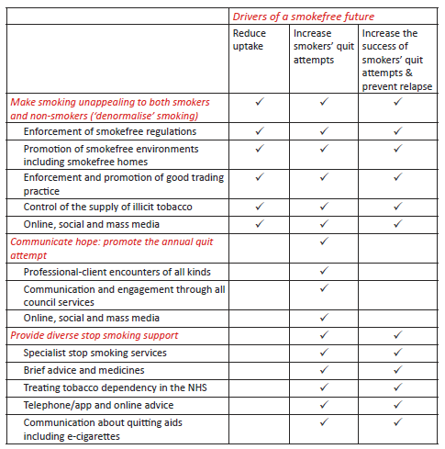
Additional Resources: The End of Smoking (Action on Smoking and Health, June 2019)
The proposed target for local areas to adopt is to: reduce smoking prevalence to below 5% in all socio-economic groups by 2029.
Currently only 30% of smokers per year make a serious attempt to quit. Most of these are unsuccessful. So only 5% of smokers successfully quit each year.
Of these successful quitters:
2% quit through stop smoking services
8% get some professional advice and use medication
4% use nicotine replacement therapy they bought at a pharmacy
35% succeed on their own without any help
41% use an e-cigarette
To reduce the smoking prevalence overall within each area requires:
reducing the uptake of smoking
increasing the number of quit attempts increasing the success of quit attempts made

Slide 18
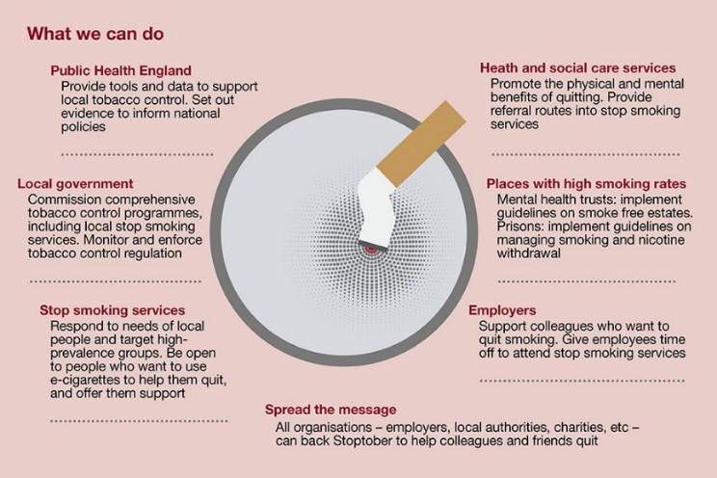
Additional Resources: Roles in tobacco control (PHE)

Slide 19
Additional Resources: Case for Investment
Multi-layered (or multicomponent) strategies are required for effective tobacco control as there are multiplicative effects between measures
Tobacco control is embedded in governmental policy (Tobacco Control Plan) and prevention is integral within the NHS Long Term Plan, with local commitments in the Derbyshire Health & Wellbeing Strategy and Joined Up Care Derbyshire prevention plan
Smoking is an important influence on healthy life expectancy. Smoking is responsible for around half the differences in life expectancy between the richest and poorest. Reducing smoking is a key priority in tackling the differences in health outcomes between communities in Derbyshire.
Smoking is a cause of ill health and preventable mortality for people of all ages. Reducing smoking rates will improve multiple indicators in the Public Health Outcomes Framework.
Secondhand smoke causes serious health harms especially for children and pregnant women, and tobacco control measures help to protect children and others from this harmful exposure.
Treating smoking related diseases costs the local NHS £39.6 million in each year through GP consultations, practice nurse consultations, outpatients visits and hospital admissions
Overall smoking costs Derbyshire £174.7 million each year, including £108.9 million from the local economy due to early deaths, sick leave and smoking breaks
Reducing smoking will increase disposable income for individuals and their families and promote economic prosperity at household and community level.
Helping smokers to quit is the single highest value contribution to health that clinicians can make.
There is a return on investment at system level associated with tobacco control measures.

